Slide 1
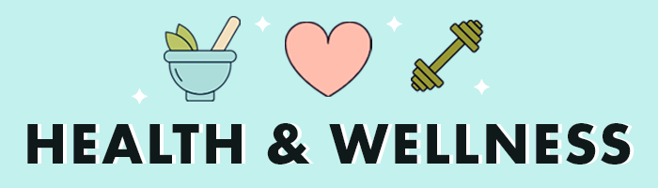
HEALTH & WELLNESS:TIPS FOR BALANCED LIFE

Slide 2
What is Health & Wellness?
World Health Organization (WHO) defines health as “a state of complete physical, mental, and social well-being and not merely the absence of disease or infirmity (illness).”
WHO defines wellness as “the optimal state of health of individuals and groups,” and wellness is expressed as “a positive approach to living.”
The primary difference between health and wellness is that health is the goal and wellness is the active process of achieving it. You truly cannot have health without first achieving wellness. Wellness has a direct influence on overall health, which is essential for living a robust, happy, and fulfilled life.

Slide 3
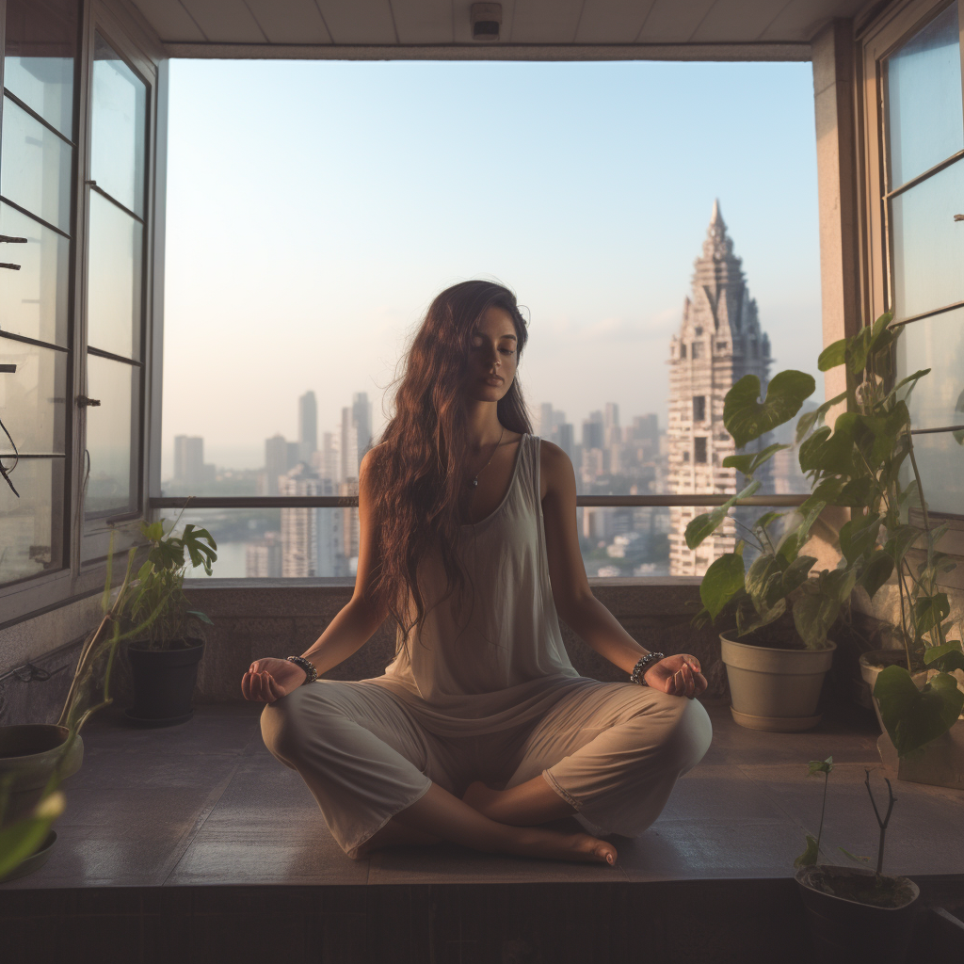
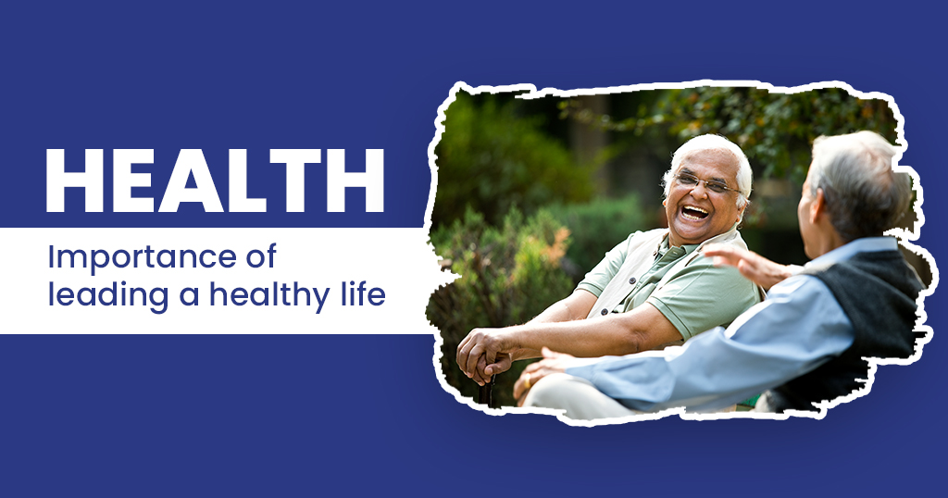
IMPORTANCE OF HEALTH
Living a healthy life would extend longevity and also regenerate the body and mind.
Having good health is of core importance to human happiness.
Health is the body’s natural functional and metabolic efficiency to adapt to physical and mental changes the body is exposed to.
Having good health helps a person to perform their daily routine in a smooth manner.
Physical health of a person means the body is not affected by any disease whereas mental or social health is characterized by the ability of a person to accomplish various social tasks given to him

Slide 4
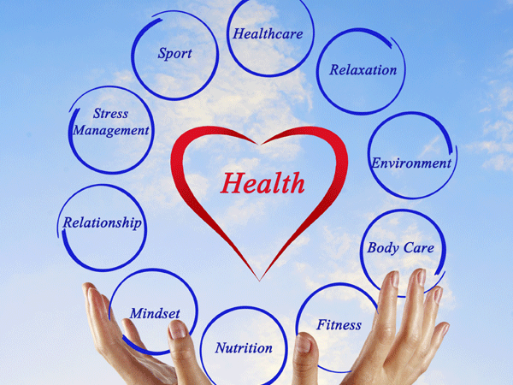
Life without good health is like an army without soldiers and chocolate without cocoa. Health is important to live life to the fullest.
When a person leads a healthy lifestyle, the body remains healthy and the mind is active and fresh
Having good health is important because
1. Improve longevity
If a person doesn’t have a healthy lifestyle, it would affect the daily routine o a person. When the body gets proper nutrition, it becomes more fit and healthy, improving longevity.
2. Prevent diseases
The most important concept of leading a healthy life is to provide immunity strength against various diseases. The immune system is the body’s natural defence mechanism to fight against foreign agents that cause harm to the body.
Having a healthy body and mind is very important for overall well-being.

Slide 5
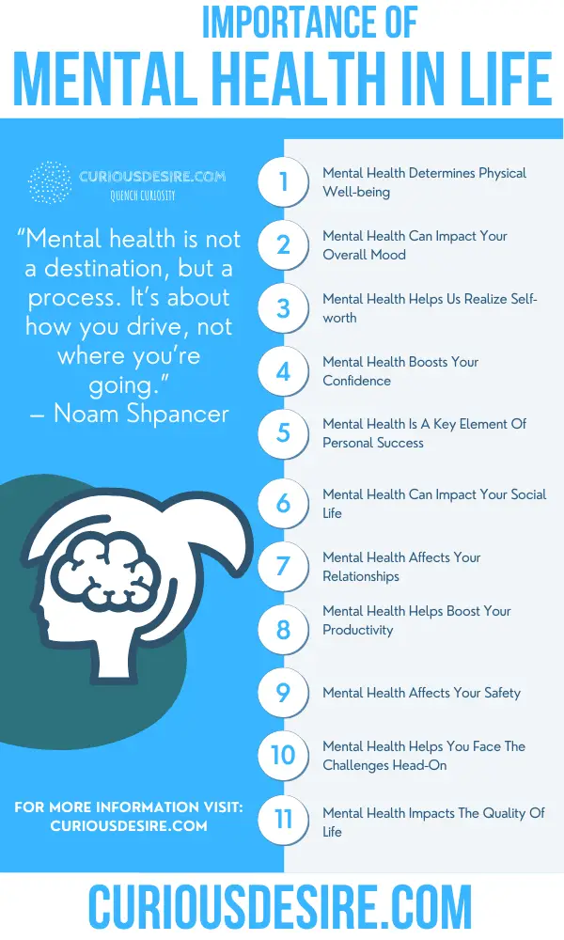
3. Improve mental health
Only when a person is happy mentally, they would perform productively. Mental health is equally important as physical health
4. Lead a productive life
A healthy person would serve his/her community and nation. Only when a person is not affected by any disease,he/she is considered healthy.This inturn would help them to serve better.
5. Financial benefits
The cost of medical expenses is rising. Only if a person invests in health right from a young age they would prevent or reduce the extent to which they develop a disease.
By having good health, they can reduce the possibilities of themselves getting hospitalized and minimize the cost incurred for medical treatment.

Slide 6
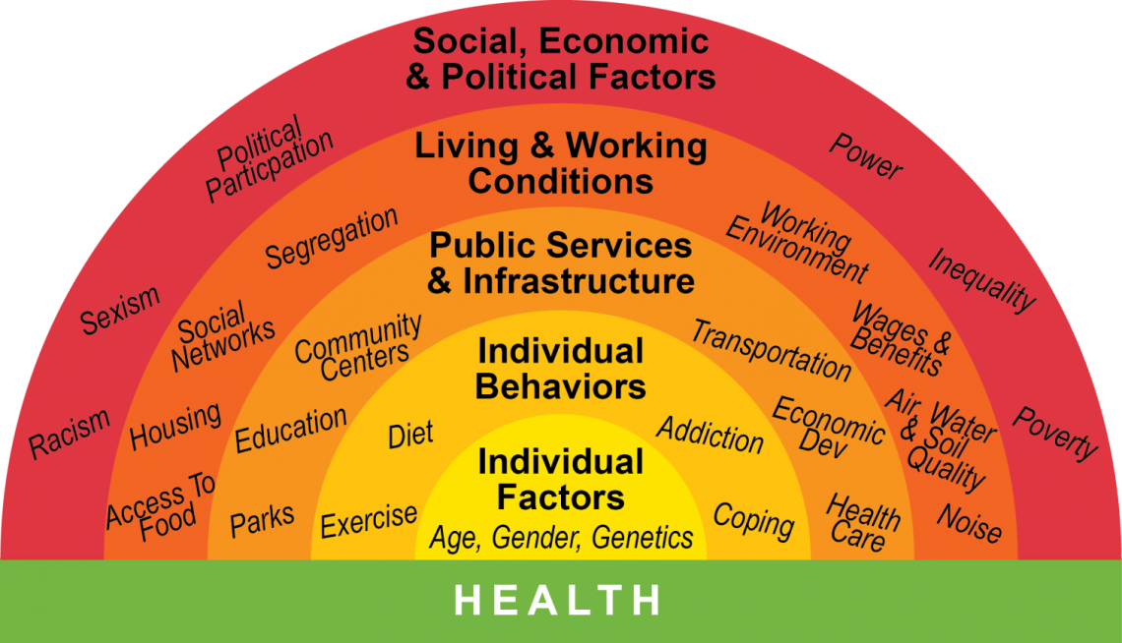
Factors Influencing Health

Slide 7
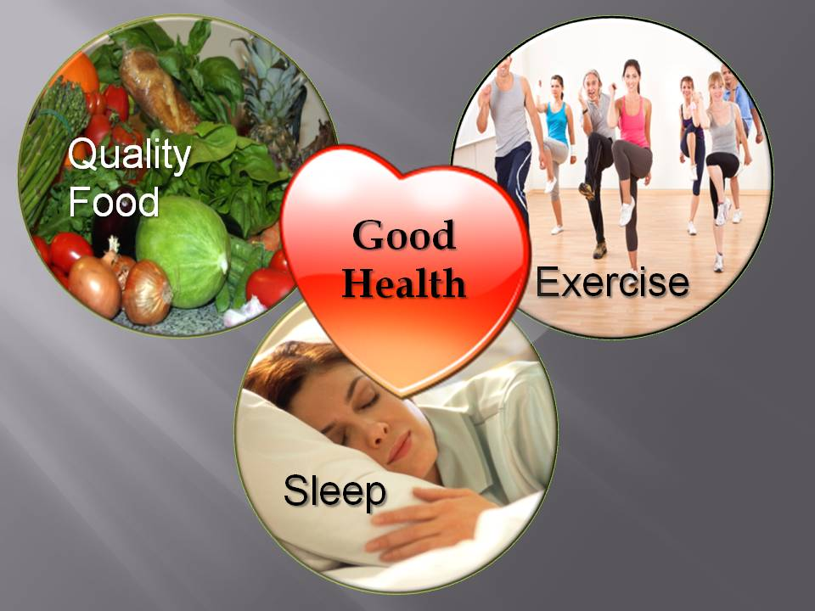

How can we achieve good health?
By adapting a few healthy lifestyles changes we can significantly improve our health.
Consuming healthy meals
Diet plays an important role in overall health. What we consume is directly related to health.
Consuming a healthy diet will boost the immune system and improve overall health.
Consuming more fruits and vegetables will improve health. Consuming fewer animal products and hydrating oneself is important.
Regular exercise and keeping the body active will improve bone density and muscle strength. Doing moderate to intense physical activities regularly has a lot of benefits.
Shedding a few pounds around the waist will keep us away from type two diabetes and other cardiovascular diseases.
Getting enough sleep is an important factor in improving health. Having proper sleep improves physical and mental health and prevent various heart diseases.
Cutting down on refined sugar has a lot of health benefits. Refined sugar has empty calories which would increase body weight and also spike blood glucose levels.
All these activities and adapting healthy practices would serve beneficial for people.

Slide 8
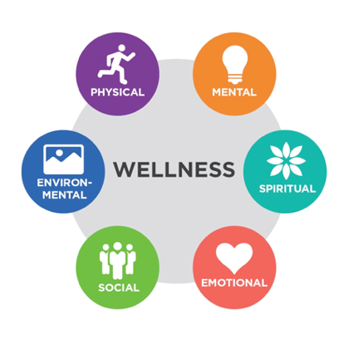
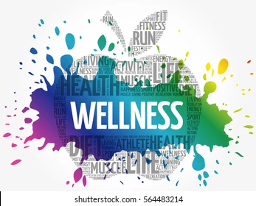
Types of Wellness
Importance of wellness is a dynamic and ongoing process that requires conscious effort and attention to various aspects of one's life to achieve optimal health and happiness and well-being.
Here are several types of wellness, including:
Physical Wellness: Importance of Wellness refers to the state of health and involves taking care of one's body through exercise, nutrition, and rest.
Emotional Wellness: Importance of Wellness refers to the ability to manage one's emotions and cope with stress, anxiety, and depression.
Social Wellness: Importance of Wellness refers to the ability to interact with others in positive and meaningful ways and build healthy relationships

Slide 9
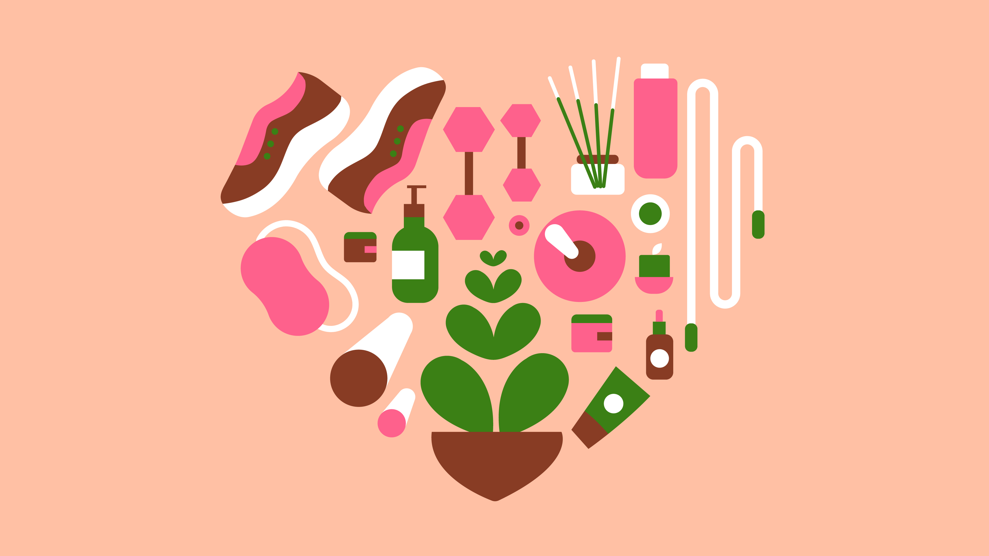

Intellectual Wellness: Importance of Wellness refers to the ability to engage in creative and stimulating mental activities, such as learning, problem-solving, and critical thinking.
Occupational Wellness: Importance of Wellness refers to the satisfaction and fulfillment that comes from one's work or career.
Spiritual Wellness: Importance of Wellness refers to the sense of purpose and meaning that comes from a connection to a higher power, nature, or a personal belief system.
Environmental Wellness: Importance of Wellness refers to the impact that the environment has on our physical and mental health, and involves taking care of the planet and reducing our carbon footprint.

Slide 10
Importance of fitness and wellness
The importance of Physical fitness and wellness are essential components of a healthy lifestyle. There are many benefits to maintaining good physical fitness and wellness, including:
Improved overall health: Regular exercise and a healthy diet can help prevent a range of health conditions, including heart disease, diabetes, and obesity.
Increased energy: Regular exercise and a healthy diet can boost energy levels and help you feel more alert and focused throughout the day.
Improved mood: Exercise has been shown to release endorphins, which can improve mood and reduce feelings of stress and anxiety.
Increased strength and flexibility: Regular exercise can help increase muscle strength and flexibility, which can help reduce the risk of injury and improve overall physical performance.
Better sleep: Regular exercise can improve sleep quality, which can have a positive impact on overall health and well-being.
Improved cognitive function: Regular exercise has been shown to improve cognitive function, including memory, attention, and decision-making.

Slide 11


How Does Nature Impact Our Wellbeing?
Research reveals that environments can increase or reduce our stress, which in turn impacts our bodies. What you are seeing, hearing, experiencing at any moment is changing not only your mood, but how your nervous, endocrine, and immune systems are working.
The stress of an unpleasant environment can cause you to feel anxious, or sad, or helpless. This in turn elevates your blood pressure, heart rate, and muscle tension and suppresses your immune system. A pleasing environment reverses that.And regardless of age or culture, humans find nature pleasing.

Slide 12


Nature heals:
Being in nature, or even viewing scenes of nature, reduces anger, fear, and stress and increases pleasant feelings. Exposure to nature not only makes you feel better emotionally, it contributes to your physical wellbeing, reducing blood pressure, heart rate, muscle tension, and the production of stress hormones
Nature soothes:
In addition, nature helps us cope with pain. Because we are genetically programmed to find trees, plants, water, and other nature elements engrossing, we are absorbed by nature scenes and distracted from our pain and discomfort.

Slide 13

Ways To Achieve Wellness
Take Proper Sleep
Eat a Balanced Diet
Expose Your Body to Sunlight
Deal with Stress
Exercise Daily
Stay Away from Smoking and Alcohol
Be Social, as Much as You Can
Find and Practice New Hobbies
Learn to Live in the Present
It’s Simple: Laugh and Enjoy!

Slide 14
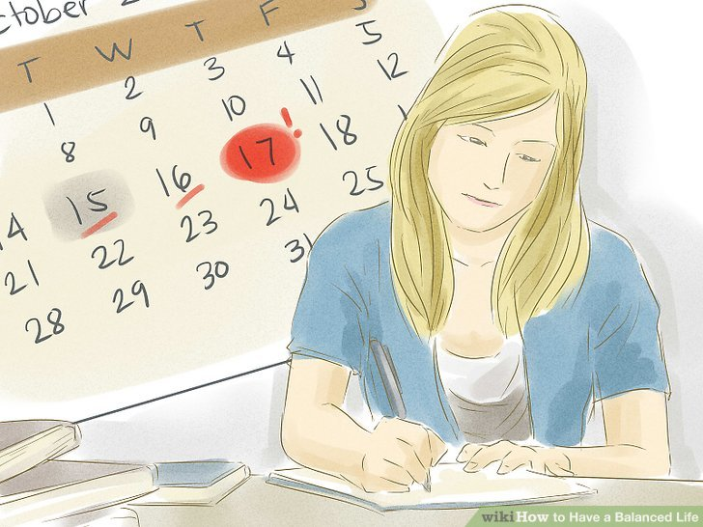
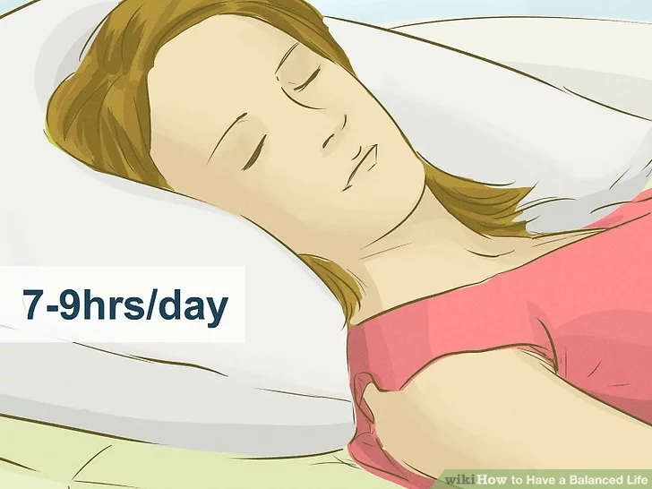
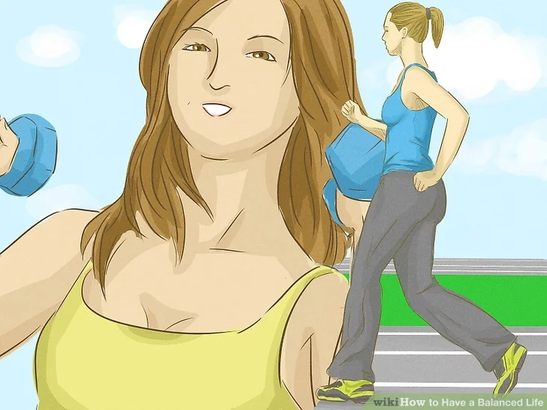
Tips For A Balanced Life
Maintain a schedule
Get good sleep
Keep your body fit

Slide 15
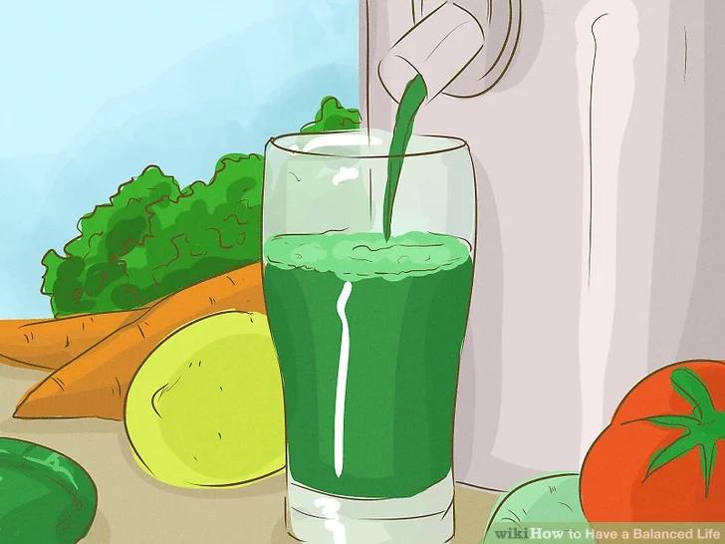

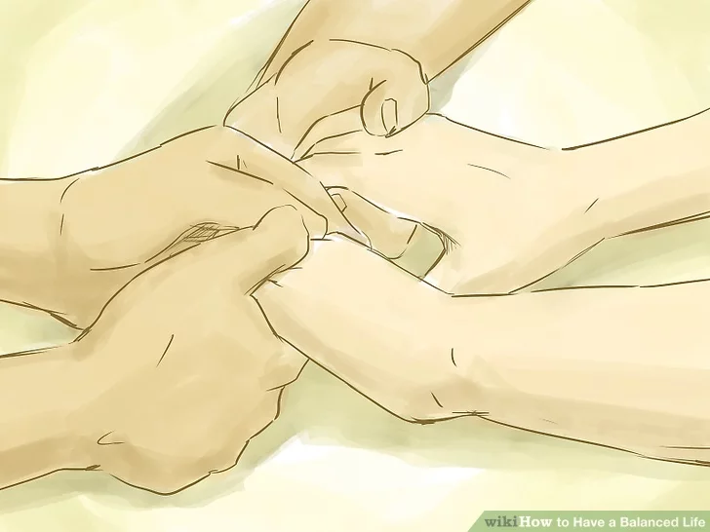
Eat nutritious foods.
Keeping a Balanced Lifestyle
Have hobbies.
Connect with spirituality

Slide 16
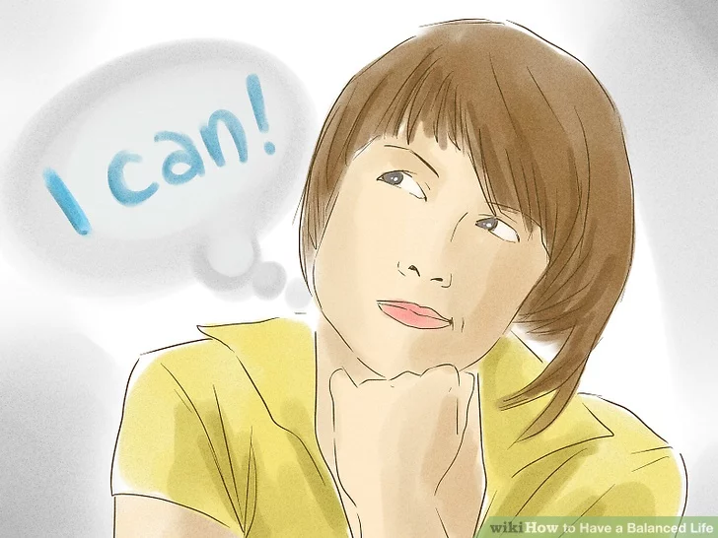
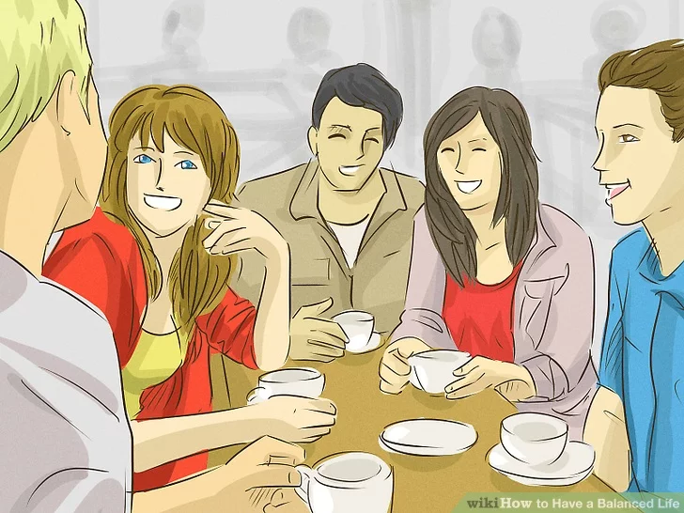
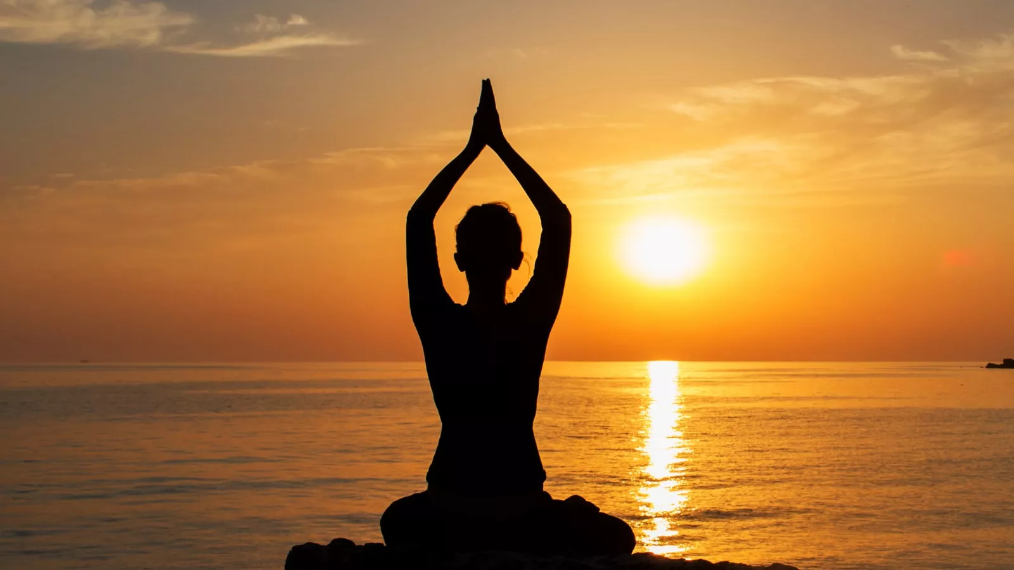
Think positively
Spend time with family and friends
Relax

Slide 17
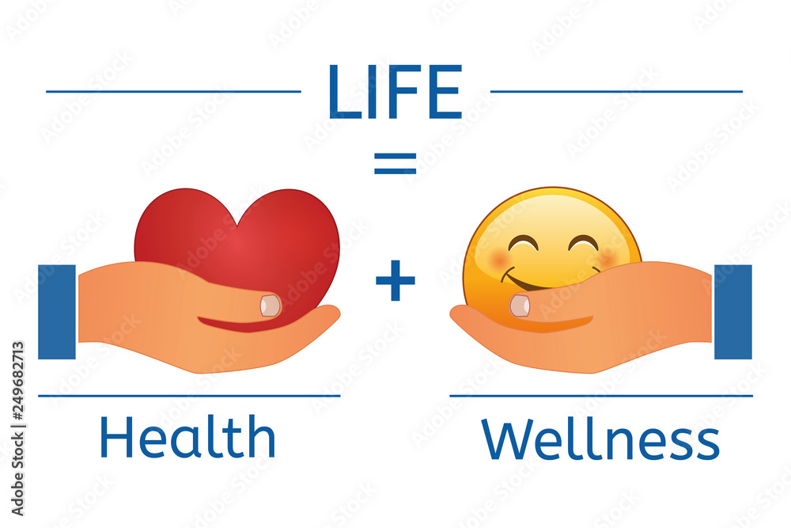

Slide 18
THANK YOU!!

